Slide 1
NE 591: Advanced Reactor Materials
Fall 2021
Dr. Benjamin Beeler

Slide 2
Last Time
Completed FCCI for metallic fuels
highlighted different compositions, and which species participate
Ce and Nd are primary FPs that diffuse into the cladding
Fe and Ni diffuse into the fuel
melting experiments to test irradiated fuel
Metal Fuel Fabrication
injection casting process

Slide 3
Mixed oxide fuel

Slide 4
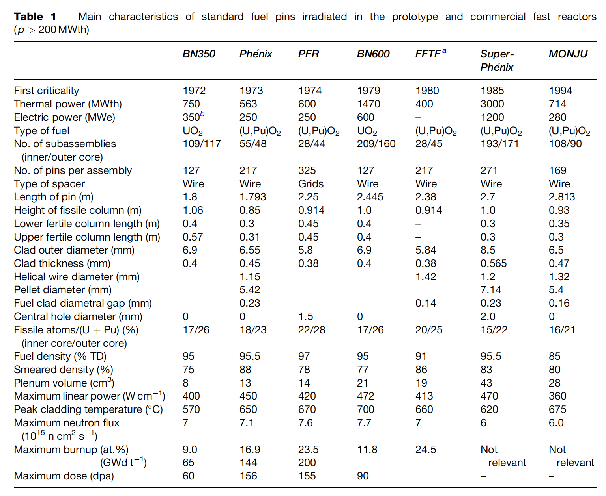
MOX Introduction
Despite some disadvantages, such as its low U density, poor thermal conductivity, and its chemical reaction with sodium, MOX fuel (U,Pu)O2 is the fuel that has been used most in fast reactors
In order to avoid the dramatic swelling of metallic fuels, MOX fuels were explored in fast reactors
Behavior was observed to be satisfactory and was relatively widely implemented in SFRs

Slide 5
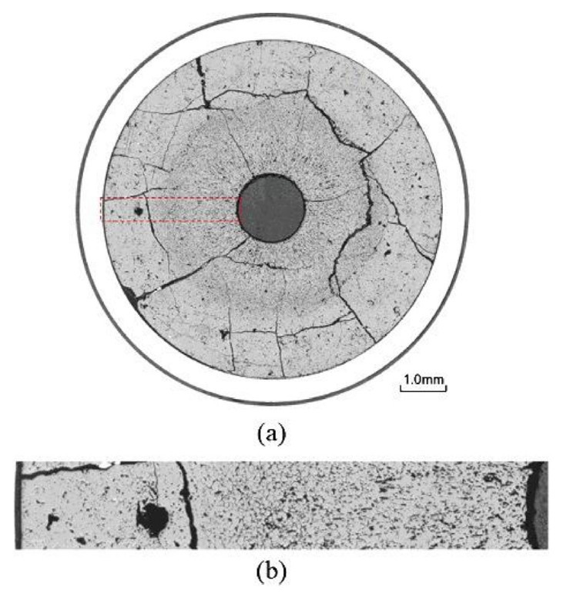
MOX Fuels in SFRs
SRFs with MOX fuel will lead the MOX to run at higher temperatures than LWR fuel, and thus with different properties
Fission product phases and evolving microstructures create highly localized properties that can differ significantly from the bulk fuel
Stoichiometry and Pu content are important factors that dictate thermal properties

Slide 6
MOX Restructuring
Oxide nuclear fuels are commonly touted for their outstanding high temperature capabilities under irradiation, but this stability comes the tradeoff of low thermal conductivity
Due to the low thermal transport, a steep temperature gradient is formed along the radius of the fuel pellet, with the hottest region at the center of the pellet and coolest near the cladding
This leads to grain growth and restructuring
Pu bearing fast reactor oxide fuels display four defining regions of a restructured pellet:
the central void, the columnar grain growth region, the equiaxed grain growth region, and the as-sintered region
The higher temperatures and heating rates form coarse, elongated grains that grow radially toward the outer rim of the fuel

Slide 7
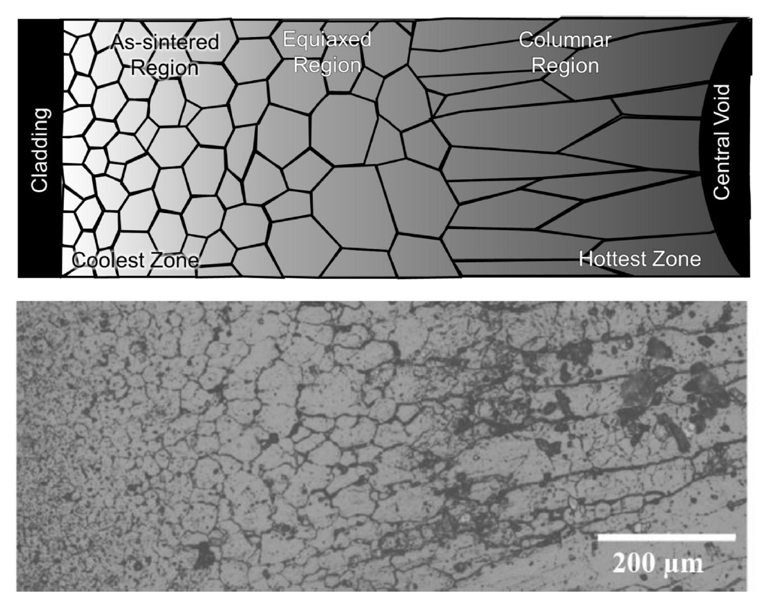
MOX Restructuring
The equiaxed region consists of grains that have undergone significant growth when compared to the un-irradiated samples
Central voids have been shown to appear in irradiation times as short as 10 min, demonstrating that the appearance the central void is a result of fuel temperature and linear heating rate, not high burnup
The central void forms from the accumulation of voids and pores present in the fuel along a thermal gradient

Slide 8
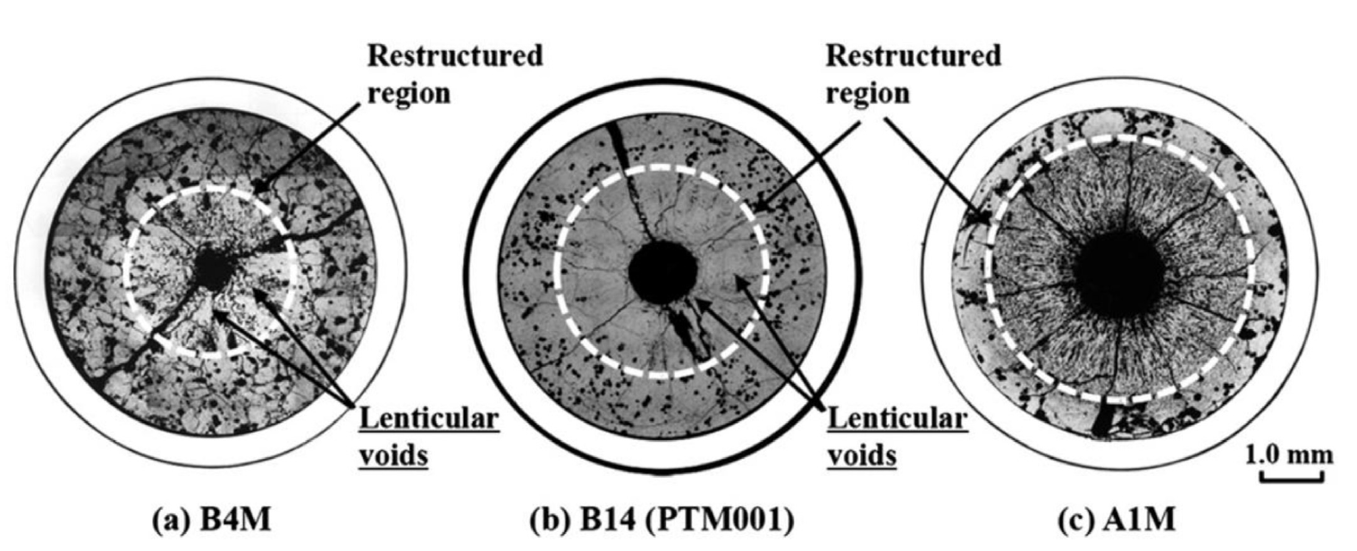
MOX Pore Formation
Heating Rate

Slide 9
MOX Pore Formation
The smallest spherical pores are highly mobile, being able to quickly and easily move through the restructured region
Intermediate sized pores become flat and elongated as they travel towards the fuel centers, leaving streaks at the tips of the voids as they travel
These “lenticular” voids are the most readily identifiable porosity feature in the irradiated MOX fuels due to their distinct shape

Slide 10
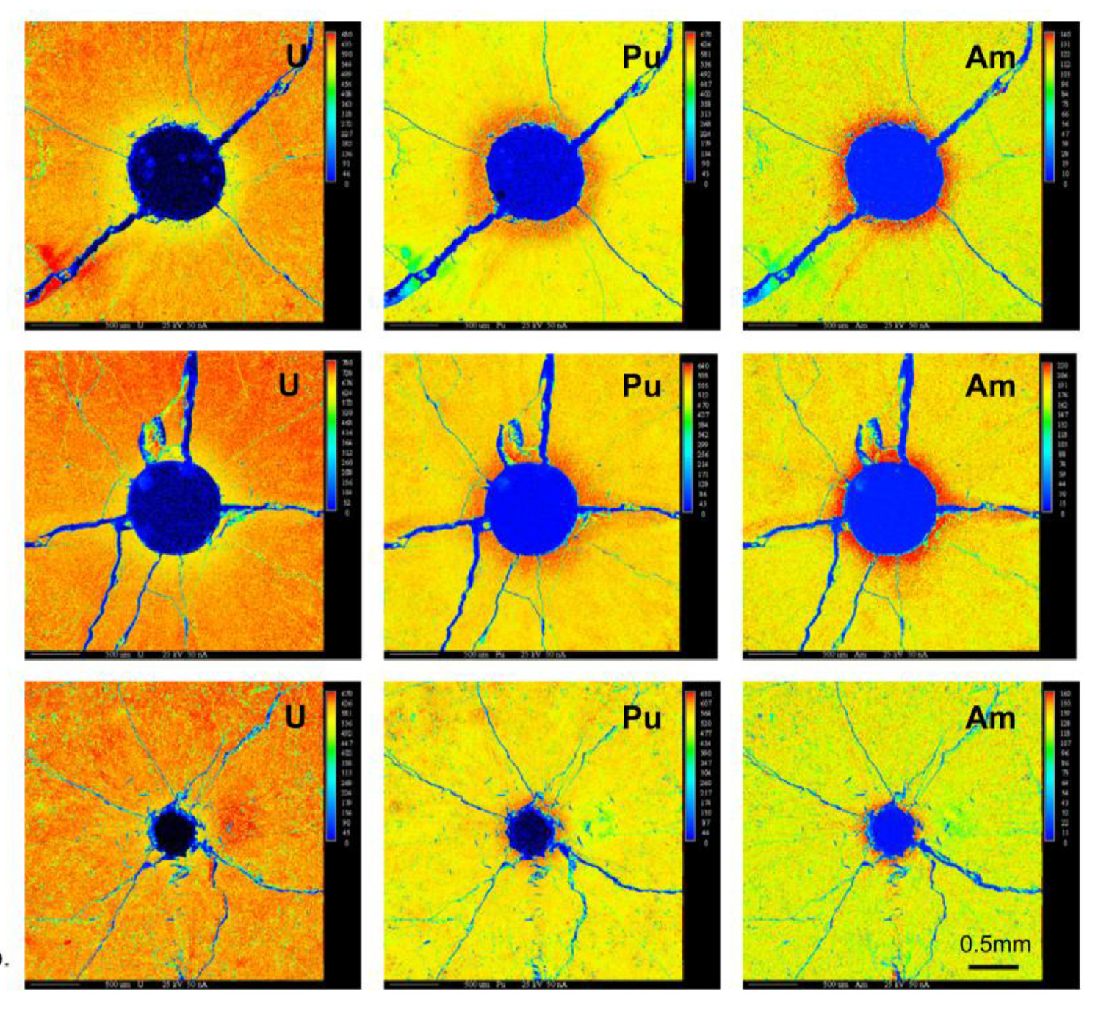
Redistribution of Pu
The movement of pores leads to a redistribution of plutonium, resulting in a spike in Pu concentration surrounding the central void
Similar behavior has been observed for americium
This transuranic concentration increase is accompanied with a decrease in U concentration
This redistribution increases the local fission rate and centerline temperature, while generating lower melting point phases

Slide 11
Redistribution of Pu
This phenomenon is currently understood as an evaporation-condensation process
The fuel at the edge of the pore closest to the centerline becomes gaseous inside the pore and deposits itself on the cooler region of the pore closest to the cladding
UO2 is the more volatile of the U/Pu heavy metal species present in the fuel matrix
The high oxygen potential can lead to a high partial pressure of UO3 within the self-contained pores
Enriched regions of PuO2 are left behind and deposited at the leading edge of the central void as the porosity agglomerates in the fuel center
Some experiments on O/M ratio seems to point towards higher O potential leading to more redistribution
While this is the working theory, it is not clear if this explanation can also account for the necessary pore velocities
No experimentally proven substitution has been put forth as a replacement theory to the observed features

Slide 12
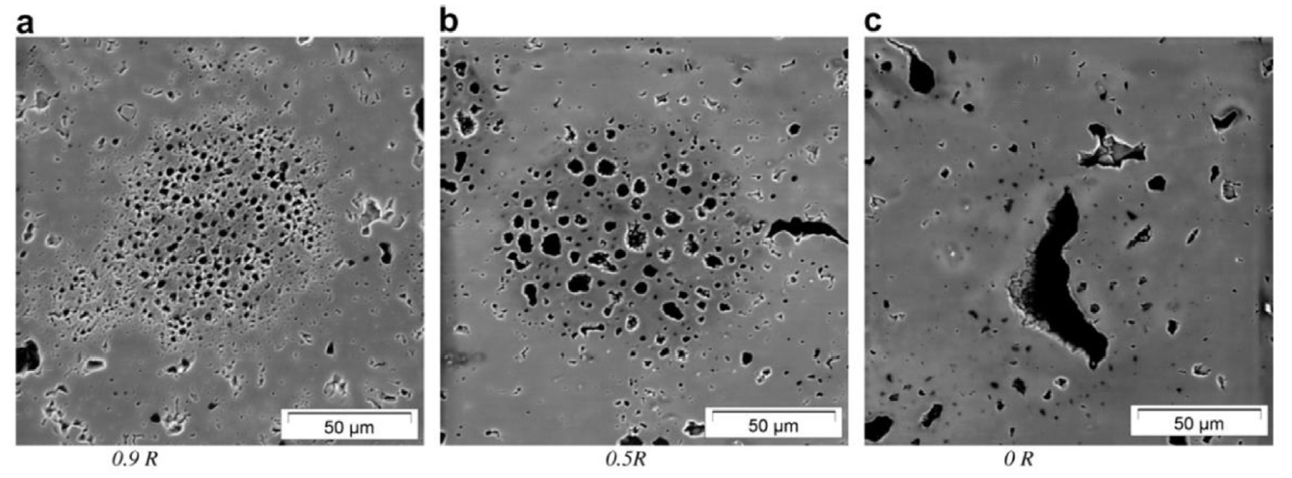
Pu-rich Agglomerates
Regions of high Pu concentration form in the MOX fuel matrix due to incomplete mixing during fabrication
Clusters of dispersed porosity form in the high Pu concentration regions because of the different fission rate
PA's are highly dense in fissile material, with the high Pu content leading to heating rates and burnups beyond the low concentration UO2 matrix material
Thermal conductivity of the spots is also lower than the surrounding matrix, thus the agglomerates are simultaneously hotter and undergo a greater number of fission events in a very small region
Burnup in these regions may be greater than 2-3 times that of the pellet as a whole

Slide 13
Pu-rich Agglomerates
The morphology of porosity in the agglomerates depends on the temperature
Toward the outer, relatively cool section of the fuel, porosity forms a large number of small bubbles, only 1-2 μm in diameter
In the intermediate radius of the pellet the densely populated, small pores start to agglomerate to form larger pores
Near the hot center of the fuel, the bubbles now reach sizes upwards of 50 μm with only a few isolated pores remaining
Porosity formed due to PA's are visually distinct from those caused by fission gas accumulation on grain boundaries and porosity formed during pellet sintering

Slide 14
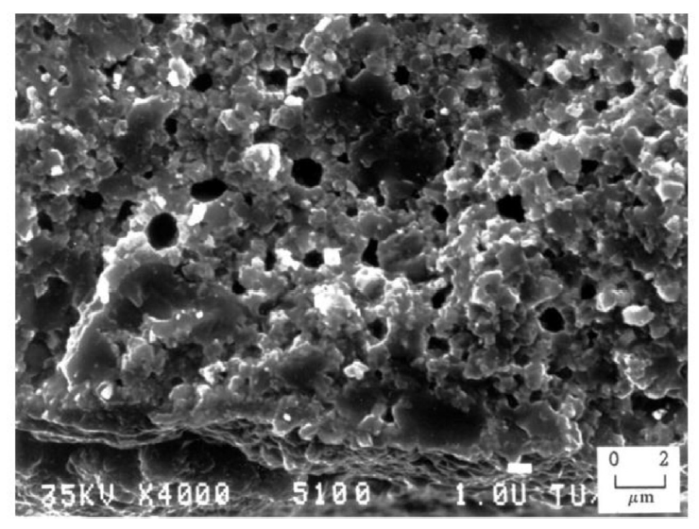
Pu-rich Agglomerates
The presence of the high burnup structure (HBS) has been observed within the PA regions
The HBS is basically a fine grained, cauliflower-like structure
In MOX fuels, the HBS structure appears in fuels following burnups between 60 and 80 GWd/tM at temperatures below approximately 1100C
PA's reach these local burnups at pellet burnups far below this threshold

Slide 15
Summary
Pyroprocessing
well established method relying on molten salt and anode deposition
Metallic fuel performance modeling
BISON, ALFUS, LIFEMETAL
all still currently require extensive assumptions
MOX intro
restructuring, Pu redistribution, Pu agglomerates

Slide 16
Questions?

